Slide 1
Building forecast models for unknown security with limited information
1C3I

Slide 2
Introduction
Unknown product, forecast the price
e.g. unseen derivative, find the value
Infer information about the security
price & fundamentals
This is Real Life!

Slide 3
Database Management
Problem: Size of Data
MongoDB + Arctic

Slide 4
Initial Approach
NLTK
Word Embeddings -> Event Embeddings
Concatenation with price
Models
LSTM
PCA + Technical Indicators

Slide 5
Data Analysis
URL news category extraction
Resampling
Trend & Correlation

Slide 6
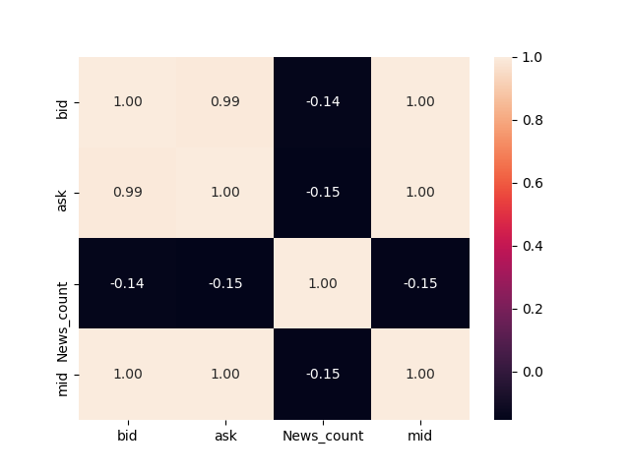
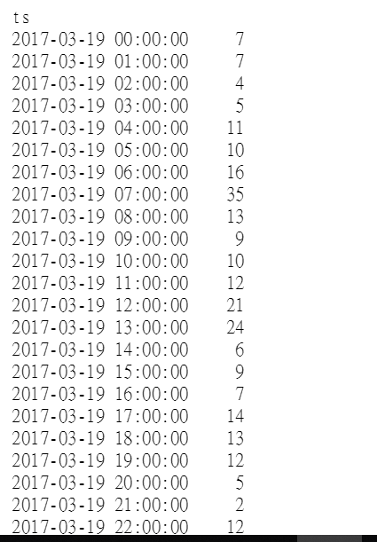
Number of news grouped by hour
Correlation Matrix
This suggests that news isn’t as useful as we initially thought…

Slide 7
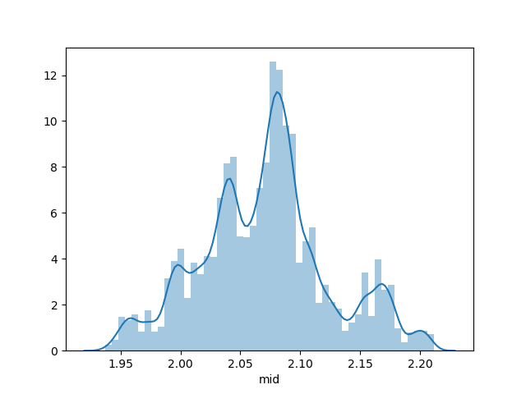
Histogram of mid prices
Looks gaussian?...

Slide 8
Hypothesis
News Data are not directly relevant
|Corr ( News, Price ) | < 0.15
Ticker demonstrates Mean Reversal behaviour
Fixed Income/ Commodities/Treasury Bonds?

Slide 9
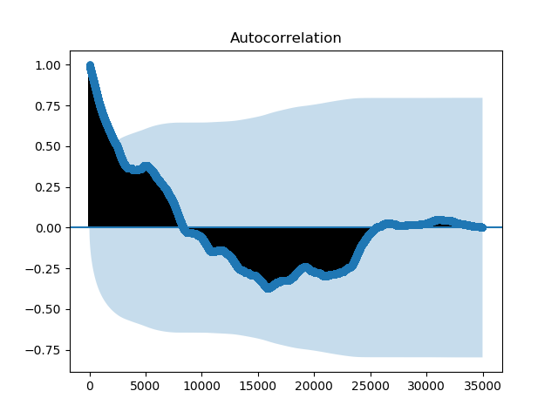
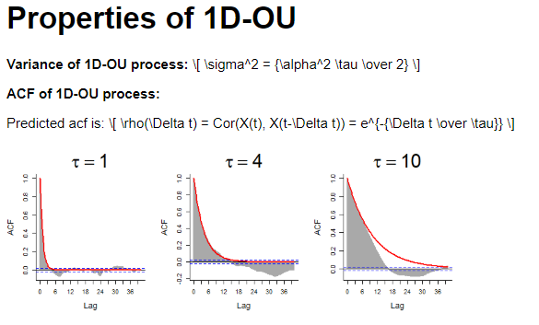
Experimental Data
Simulated OU process
Looks similar!

Slide 10
Ornstein – Uhlenbeck Process
Mean Reversal Behaviour
dXt = κ(θ – Xt)dt + σdWt
Estimate κ, θ, σ
Simulate, MLE
Auto Covariance Function(ACF) shows exponential decay
Auto Correlation and memory of process

Slide 11
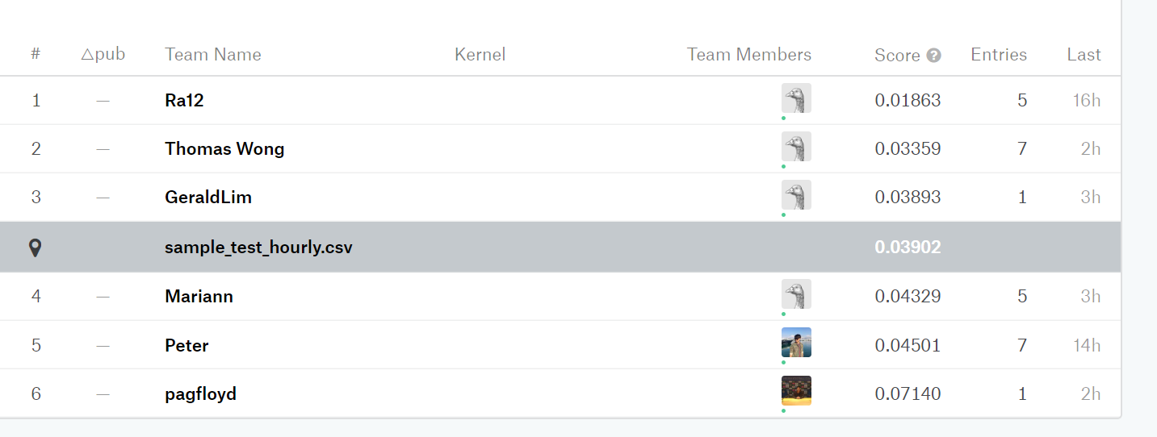
Results
Kaggle
PCA and LSTM gave results WORSE than the benchmark
Suspected reason: Overfitting
OU performs best
Robust method, tested for slight change of parameters -> similar results
General pre screening method for forecast in fixed income and commodities

